Slide 1







FUZZY LOGIC - BASED CLASSIFICATION SYSTEM FOR DIABETES RISK PREDICTION
BCS2313
ARTIFICIAL INTELLIGENCE TECHNIQUE

Slide 2



Objective
To develop and implement a fuzzy logic-based classification system for automated diabetes diagnosis and risk assessment.

Slide 3




Fuzzy Logic Implementation
Method Used:
  Used 8 health indicators as input
  Applied fuzzy rules using Mamdani Inference
  Produced a Risk Score and Classification
Reasons:
Mimics human reasoning
Works with uncertainty and vague inputs
Interpretable and explainable decisions

Slide 4
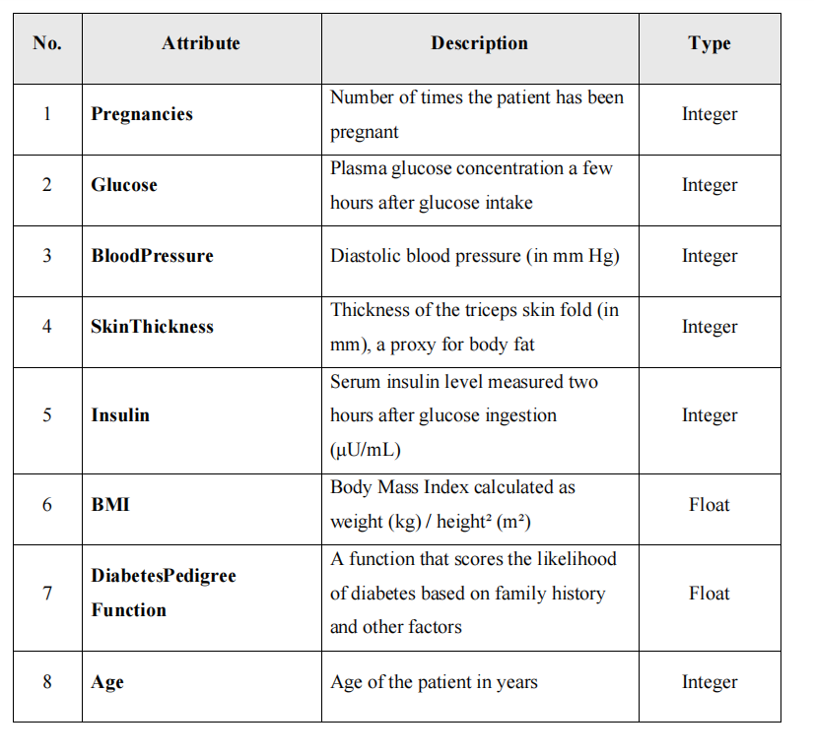
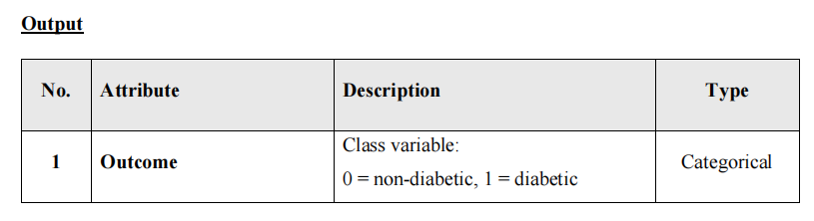
Used 8 health indicators as input
Output:

Slide 5


JOURNAL

Slide 6
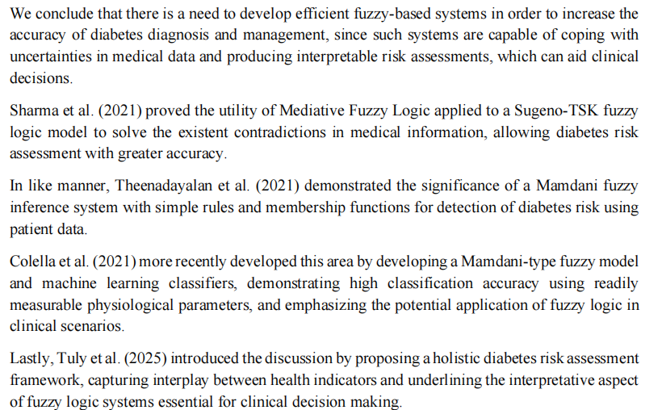
JOURNAL
We conclude that there is a need to develop efficient fuzzy-based systems in order to increase the
accuracy of diabetes diagnosis and management, since such systems are capable of coping with
uncertainties in medical data and producing interpretable risk assessments, which can aid clinical
decisions

Slide 7
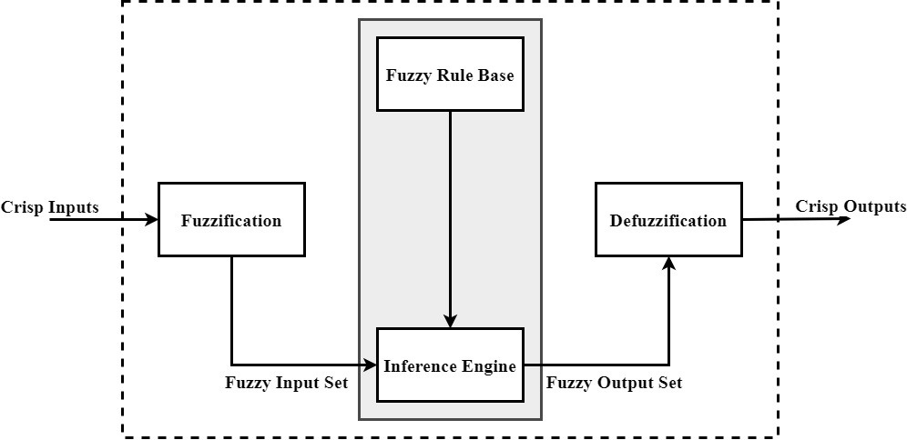
Fuzzy Logic Framework

Slide 8
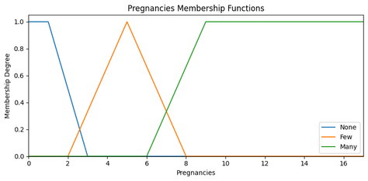
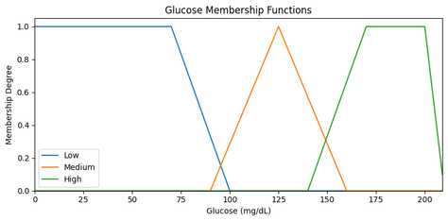
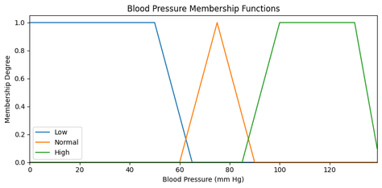
Input & Membership Functions
Input Variables:
(1) Pregnancies, (2) Glucose, (3) BloodPressure, (4) SkinThickness, (5) Insulin, (6) BMI, (7) Diabetes Pedigree Function (DPF), (8) Age
Each mapped to: Low, Medium, High
Output: Risk = Low, Medium, High

Slide 9

Rule Base
Total: 40 rules
Examples:
IF Glucose is High AND BMI is High
THEN Risk is High
IF Glucose is Low AND Age is Young
THEN Risk is Low
IF Pregnancies are Few
AND Glucose is Medium
THEN Risk is Medium
Designed to reflect real-world medical reasoning

Slide 10

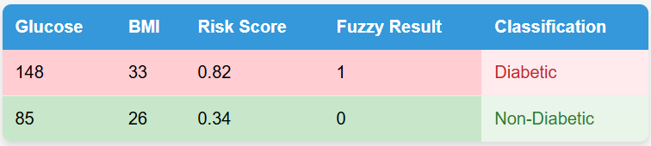
Classification Output
New Columns Added to Dataset:
  Risk_Score → crisp output from fuzzy system
  Fuzzy_Result → binary label (0 = Non-Diabetic, 1 = Diabetic)
  Fuzzy_Classification → readable output

Slide 11

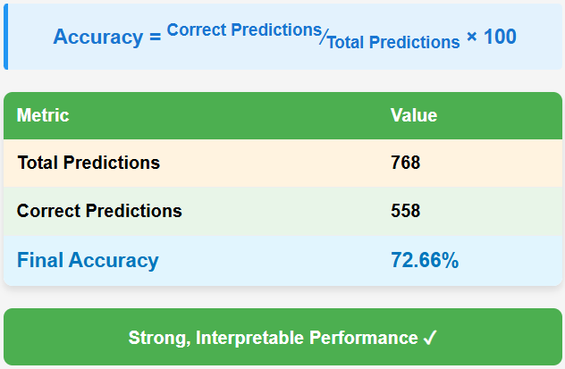
Evaluation & Accuracy

Slide 12
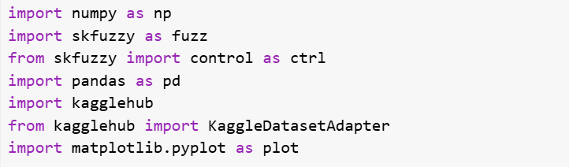
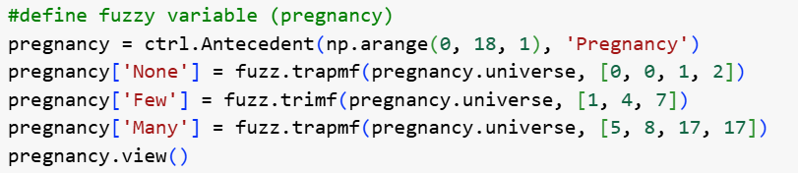
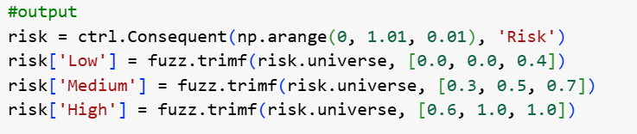
Code Implementation
Import related libraries
Define fuzzy input variable for each
Output variable : risk

Slide 13
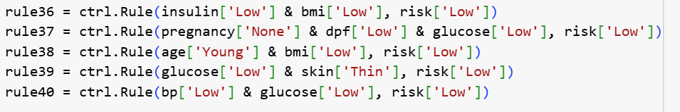
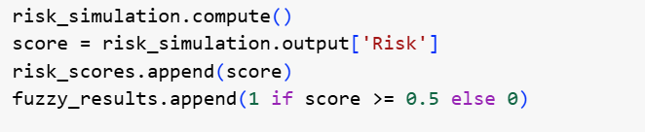

Code Implementation
Define fuzzy rules
Create a simulation system
Predict risk for each report
Calculate accuracy

Slide 14

Conclusion
  Successfully applied fuzzy logic to classify diabetes
  Interpretable rules with explainable outcome
  No need for training or ML models
  Achieved 72.66% accuracy using human-like reasoning
  Fuzzy logic is suitable for healthcare applications

Slide 15
THANK YOU!

